Slide 1
MongoDB Deep Dive

Slide 2
Outline
Introduction
Key Features
Comparison with SQL
MongoDB GridFs
MongoDB Compass
Map Reduce
Geospatial Queries
MongoDB Stitch
MongoDB Tools
Why/When to use ?
Use Cases
References

Slide 3
Introduction
MongoDB is an open-source, non-relational database developed by MongoDB, Inc.
MongoDB stores data in flexible JSON like document.
Schema less and self-describing.

Slide 4
Sample Document
{ _id: ObjectId(7df78ad8902c) title: 'MongoDB Deep Dive', description: 'MongoDB is NOSQL document based database', by: ‘Mongo DB', url: 'http://mongodb.com', tags: ['mongodb', 'database', 'NoSQL'], likes: 100, comments: [ { user:'Vijay', message: 'My first comment', dateCreated: new Date(2018,1,20,2,15), like: 0 }, { user:'Jack', message: 'My second comments', dateCreated: new Date(2018,1,25,7,45), like: 5 } ] }

Slide 5

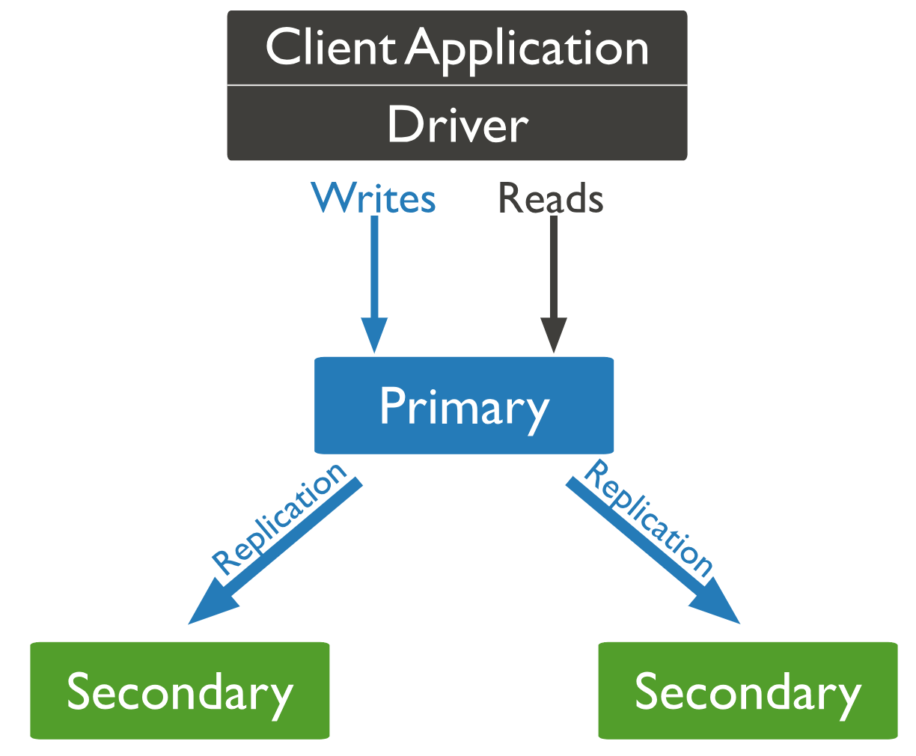
Key Features
High Performance
Support for embedded data models reduces I/O activity on database system.
Indexes support faster queries and can include keys from embedded documents and arrays.
Horizontal Scalability
Sharding distributes data across a cluster of machines.
Starting in 3.4, MongoDB supports creating zones of data based on the shard key. In a balanced cluster, MongoDB directs reads and writes covered by a zone only to those shards inside the zone.
Rich Query Language
CRUD Operations
Data Aggregation
Text Search and Geospatial Queries.
High Availability
MongoDB’s provides facility, called replica set.
automatic failover and
data redundancy.
oplog
Support for Multiple Storage Engines
WiredTiger Storage Engine
In-Memory Storage Engine
MMAPv1 Storage Engine (Deprecated in MongoDB 4.0)

Slide 6
Comparison with SQL
SQL | MongoDB
Table | Collection
Row | Document
Column | Field
JOINs | Embedded documents, $lookup & $graphLookup
GROUP_BY | Aggregation Pipeline

Slide 7
Create/Alter Queries
Oracle | MongoDB
CREATE TABLE people (id MEDIUMINT NOT NULL AUTO_INCREMENT, user_id Varchar(30), age Number, status char(1), PRIMARY KEY (id)); INSERT INTO people(user_id,age, status) VALUES ("bcd001", 45, "A") | db.people.insertOne({ user_id: "bcd001", age: 45, status: "A" }); db.createCollection("people"); db.createCollection( "products", { capped: true, size: 100000 }); db.products.insertMany( [ { item: "card", qty: 15 }, { item: "envelope", qty: 20 }, { item: "stamps" , qty: 30 }] );
ALTER TABLE people DROP COLUMN join_date | db.people.updateMany({ }, { $unset: { "join_date": "" } });
CREATE INDEX idx_user_id_asc ON people(user_id) | db.people.createIndex( { user_id: 1 } );
DROP TABLE people | db.people.drop();

Slide 8
Select Queries
Oracle | MongoDB
SELECT * FROM people; | db.people.find();
SELECT user_id, status FROM people WHERE status = "A" | db.people.find({ status: "A" },{ user_id: 1, status: 1, _id: 0 })
SELECT * FROM people WHERE status = "A" OR age = 50 | db.people.find({ $or:[ { status: "A" } ,{ age: 50 } ] })
SELECT * FROM people WHERE age > 25 AND age <= 50 | db.people.find( { age:{ $gt:25, $lte: 50 } })
SELECT * FROM people WHERE user_id like "%bc%" | db.people.find( { user_id: /^bc/ } ) db.people.find( { user_id: { $regex: /^bc/ } } )
SELECT * FROM people WHERE user_id like "bc%"; | db.people.find( { user_id: { $regex: /^bc/ } } );

Slide 9
Select Queries Continued..
Oracle | MongoDB
SELECT * FROM people WHERE status = "A" ORDER BY user_id ASC; | db.people.find( { status: "A" } ).sort( { user_id: 1 } );
SELECT COUNT(*) FROM people; | db.people.count(); -or- db.people.find().count();
SELECT COUNT(user_id) FROM people; | db.people.count( { user_id: { $exists: true } } ); -or- db.people.find( { user_id: { $exists: true } } ).count()
SELECT DISTINCT(status) FROM people; | db.people.aggregate( [ { $group : { _id : "$status" } } ]);
SELECT * FROM people LIMIT 5 SKIP 10; | db.people.find().limit(5).skip(10);
EXPLAIN SELECT * FROM people WHERE status = "A; | db.people.find( { status: "A" } ).explain();

Slide 10
Update/Delete Queries
Oracle | MongoDB
UPDATE people SET status = "C" WHERE age > 25 | db.people.updateMany({ age: { $gt: 25 } }, { $set: { status: "C" } });
UPDATE people SET age = age + 3 WHERE status = "A"; | db.people.updateMany({ status: "A" } ,{ $inc: { age: 3 } });
DELETE FROM people WHERE status = "D"; | db.people.deleteMany( { status: "D" } );
DELETE FROM people; | db.people.deleteMany({});

Slide 11
Schema Validator
db.createCollection( "contacts",
{ validator: { $or:
[
{ phone: { $type: "string" } },
{ email: { $regex: /@mongodb\.com$/ } },
{ status: { $in: [ "Unknown", "Incomplete" ] } }
]
}
} )

Slide 12
MongoDB Specific Queries
db.restaurant.replaceOne({ "name" : "Pizza Rat's Pizzaria" },{ $set: {"_id" : 4, "violations" : 7, "borough" : "Manhattan" } },{ upsert: true });
db.products.remove( { qty: { $gt: 20 } } )
db.collection.ensureIndex();
db.collection.getIndexes();
db.collection.bulkWrite({ insertOne : { "document" : <document> } }] );
db.orders.aggregate([{ $match: { status: "A" } },{ $group: { _id: "$cust_id", total: { $sum: "$amount" } } }, { $sort: { total: -1 } } ],{explain: true});
db.collection.copyTo(newCollection);
db.collection.renameCollection("newCollectionName");
db.people.findAndModify({query: { name: "Tom", state: "active", rating: { $gt: 10 } }, sort: { rating: 1 }, update: { $inc: { score: 1 } }});
db.posts.find({$text:{$search:"west"}}

Slide 13
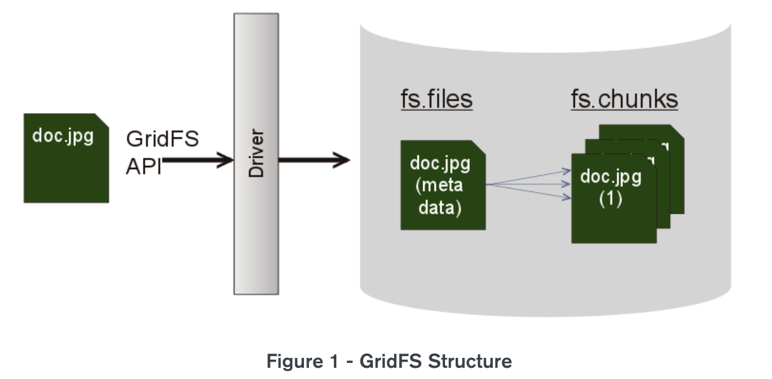
MongoDB GridFS
API provided by MongoDB for storing and retrieving large files such as images, audio files, video files, etc.
GridFS uses two collections to store files.
chunks
files
GridFS divides a file into chunks and stores each chunk of data in a separate document, each of maximum size 255k.
Eg:
mongofiles -d gridfs put /Users/vinayk/Downloads/ARR.mp3

Slide 14
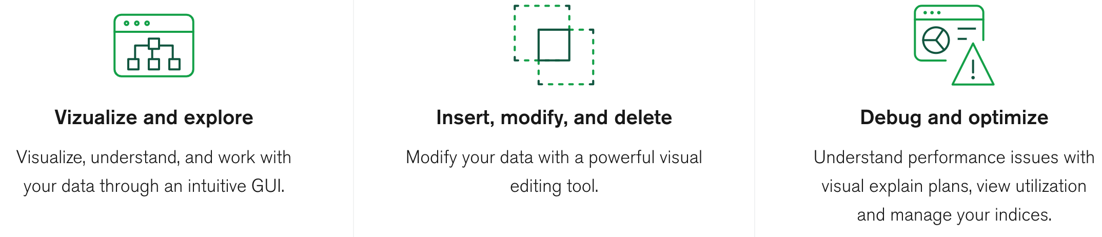
MongoDB Compass
It provides users with a graphical view of their MongoDB schema without the need of query language.
It also analyses documents and displays rich structures inside this intuitive GUI.
Supports quick insight into server status and query performance
Helps users to take decisions about indexing, document validation, and more.
No need to write command line.

Slide 15
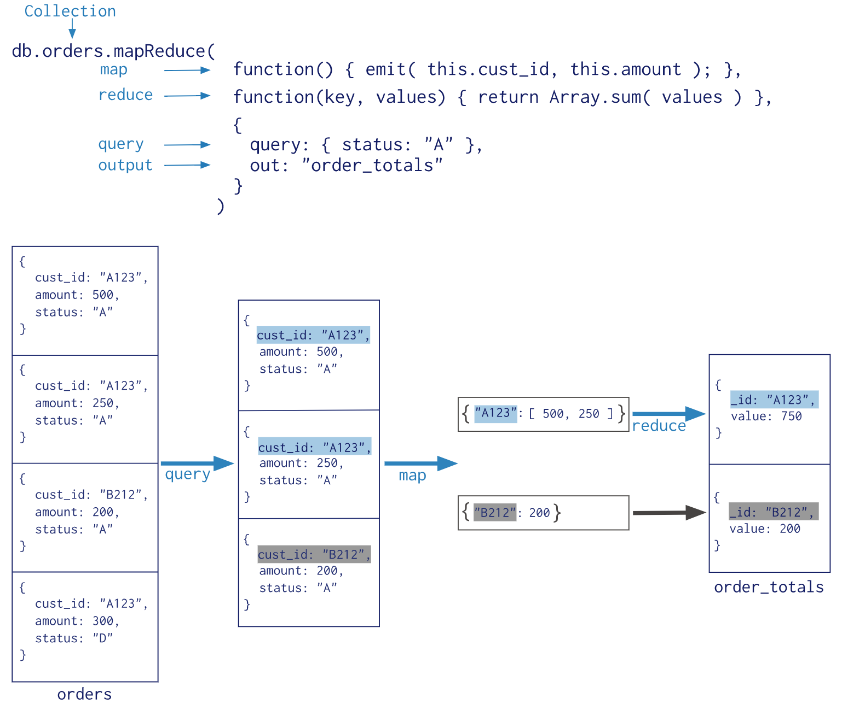
MapReduce
Data processing paradigm for condensing large volumes of data into useful aggregated results.
Map: – It is a JavaScript function. It is used to map a value with a key and produces a key-value pair.
Reduce: – It is a JavaScript function. It is used to reduce or group together all the documents which have the same key.
Query: – It is used to specify the optional selection criteria for selecting documents.
Out: – It is used to specify the location of the map-reduce query output.
Sort: – It is used to specify the optional sort criteria.
Limit: – It is used to specify the optional maximum number of documents which are desired to be returned

Slide 16
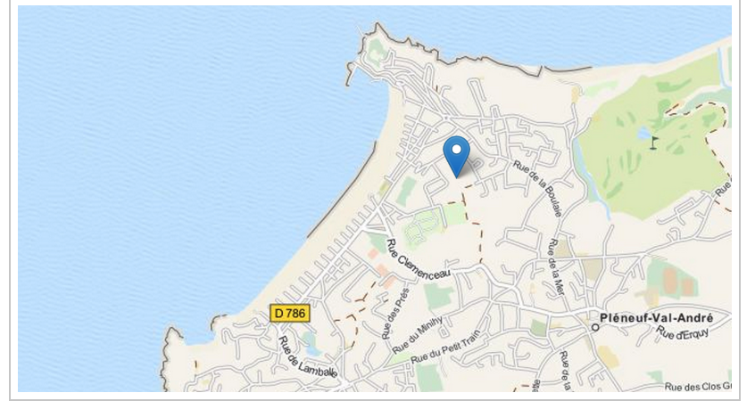
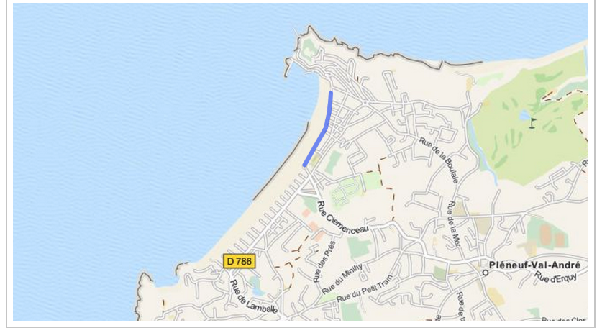
Geospatial Queries
MongoDB supports query operations on geospatial data.
Can store geospatial data as GeoJSON objects or as legacy coordinate pairs.
Longitude, latitude order
GeoJson Types:-
Point - To store the exact location or an address. { "type": "Point", "coordinates": [ -2.5469, 48.5917 ] }
LineString - Used to define boundaries, walls, barriers, roads.
{ "type": "LineString", "coordinates": [ [-2.551082,48.5955632], [-2.551229,48.594312], [-2.551550,48.593312], [-2.552400,48.592312], [-2.553677, 48.590898] ] }

Slide 17
Polygon - Used to define an area covered by a city, state or a country.
{ type: "Polygon", coordinates: [ [ [ 0 , 0 ] , [ 3 , 4 ] , [ 4 , 1 ] , [ 0 , 0 ] ] ] }
Multipoint - Used to locate similar places in maps in the form of coordinates
{ type: "MultiPoint", coordinates: [ [ -73.980, 40.8503 ], [ -73.998, 40.4968 ], [ -73.737, 40.2648 ], [ -73.940, 40.7281 ] ] }
MultiLineString - Used to store details about roads or path passing through a certain area.
{ type: "MultiLineString", coordinates: [ [ [ -73.9643, 40.7859 ], [ -73.9608, 40.7805 ] ], [ [ -73.9415, 40.7929 ], [ -73.9554, 40.7884 ] ], [ [ -73.9162, 40.7825 ], [ -73.9634, 40.7775 ] ], [ [ -73.9780, 40.7724 ], [ -73.9706, 40.7681 ] ] ] }

Slide 18
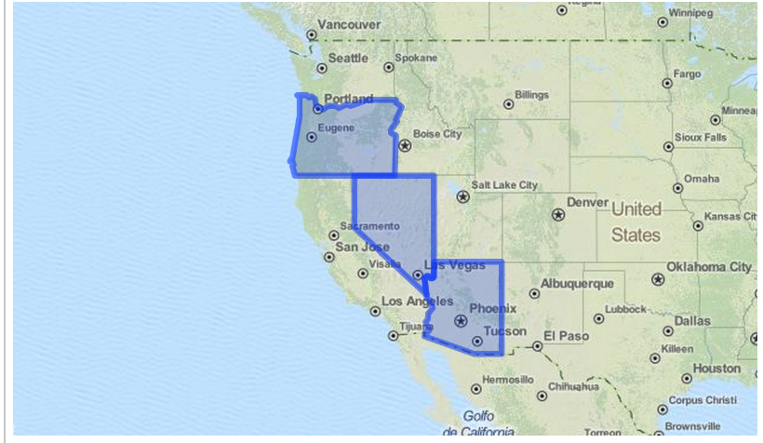
MultiPolygon - Defines various group of areas distributed over certain regions.
{ type: "MultiPolygon", coordinates: [ [ [ [ -73.958, 40.8003 ], [ -73.9498, 40.7968 ], [ -73.9737, 40.7648 ],
[-73.9814, 40.7681 ], [ -73.958, 40.8003 ] ] ],
[ [ [ -73.958, 40.8003 ],[ -73.9498, 40.7968 ],[ -73.9737, 40.7648 ],
[-73.958, 40.8003 ] ] ]
] }

Slide 19
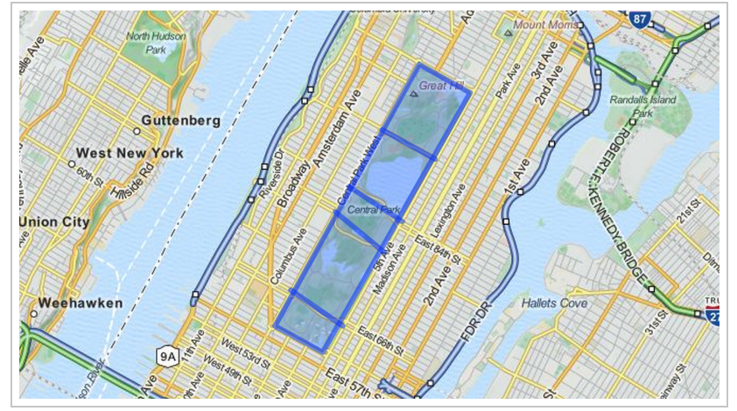
GeometryCollection - Object containing multiple GeoJSON objects in the form of a single GeoJSON GeometryCollection object.
{ "type" : "GeometryCollection", "geometries" : [ { "type" : "Polygon", "coordinates" : [ [ [ -73.9580, 40.8003 ], [ -73.9498, 40.7968 ], [ -73.9737, 40.7648 ], [ -73.9814, 40.7681 ], [ -73.9580, 40.8003 ] ] ] }, { "type" : "MultiLineString", "coordinates" : [ [ [ -73.96943, 40.78519 ], [ -73.96082, 40.78095 ] ], [ [ -73.96415, 40.79229 ], [ -73.95544, 40.78854 ] ], [ [ -73.97162, 40.78205 ], [ -73.96374, 40.77715 ] ], [ [ -73.97880, 40.77247 ], [ -73.97036, 40.76811 ] ] ] } ] }
MongoDB provides an exhaustive list of Geospatial operators and queries to play around within geospatial data.

Slide 20
Example
db.airports.insert( { "name" : "John F Kennedy Intl", "type" : "International", "code" : "JFK", "loc" : { "type" : "Point", "coordinates" : [ -73.778889, 40.639722 ] } } )
Finding nearby Restaurants
$geoIntersects - To determine the user’s current neighborhood.
$geoWithin - To show the number of restaurants in that neighborhood.
$nearSphere - To find restaurants within a specified distance of the user.
$centerSphere - MongoDB-specific syntax to denote a circular region

Slide 21
MongoDB Stitch
MongoDB Stitch is a Backend as a Service (BaaS) that allows you to easily configure authentication, data access rules, and services.
A powerful suite of services that allow teams to safely expose their data from their frontend, build backend logic, third-party service integrations, or APIs and run code in response to data changes.
Features:
Query Anywhere, i.e query data stored in MongoDB directly from your client application code with the MongoDB query language.
Serverless Functions, Stitch Functions allow you to define and execute server-side logic for your application.
Support for MongoDB Mobile.
Triggers -
Database trigger
Allows execution of server-side logic whenever a document is added, updated, or removed in a linked MongoDB cluster.
Authentication Trigger
Advanced user management, including storing new user data in MongoDB, maintaining data integrity when a user is deleted, or calling a service with a user’s information when they log in.

Slide 22
Drivers
Java
Python
Pearl
PHP
Node JS
C, C++
Ruby
Scala
Example:- (Java)
<dependency> <groupId>org.mongodb</groupId> <artifactId>mongodb-driver-sync</artifactId> <version>3.9.1</version> </dependency>
MongoClient mongoClient = new MongoClient("localhost", 27017);
Mongo mongo = new Mongo("localhost", 27017);
DB database = mongoClient.getDB("myMongoDb");
boolean auth = database.authenticate("username", "pwd".toCharArray());
DBCollection collection = database.getCollection("customers");
BasicDBObject document = new BasicDBObject();
document.put("name", "Vijay");
collection.insert(document);

Slide 23
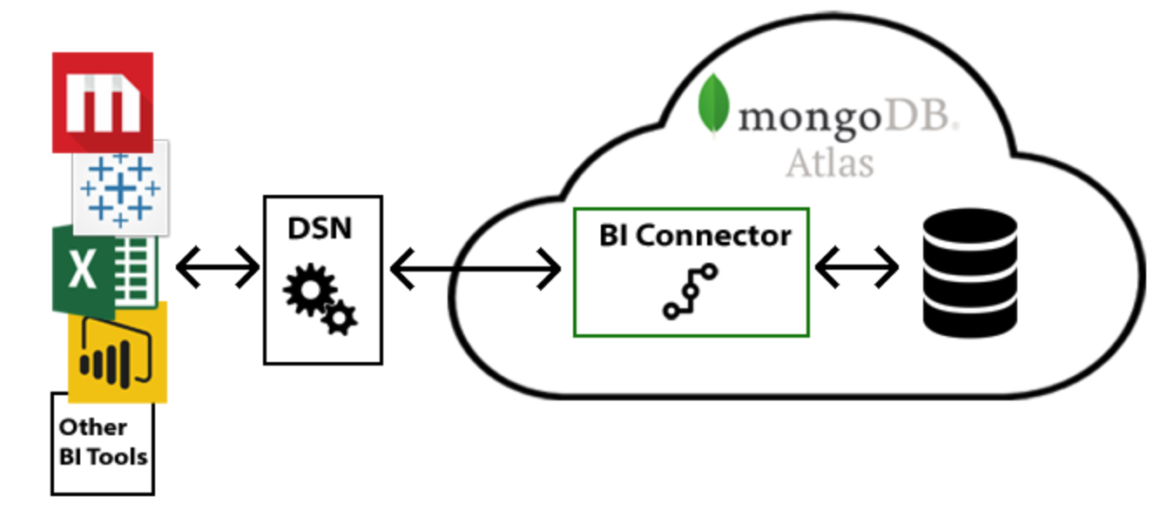
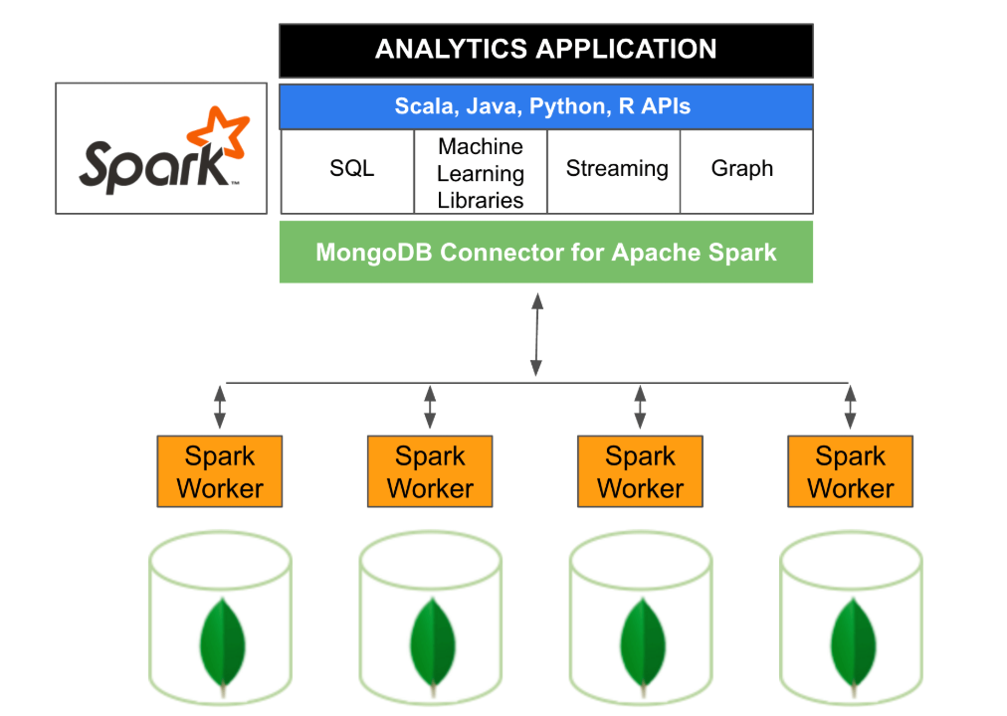
MongoDB Tools
MongoDB Mobile:
A mobile-optimized version of the MongoDB database that runs locally on the device, enabling offline access to data.
Native Java (Android) and Swift (iOS) SDKs that manage the lower-level database operations and provide methods to interact with MongoDB Mobile and the Stitch backend.
MongoDB Connector for BI:
Allows users to create queries with SQL and visualize, graph,
and report on their MongoDB Enterprise data.
Tableau, MicroStrategy, Power BI and Qlik.
MongoDB Connector for Spark:
Exposes all of Spark’s libraries, including Scala, Java, Python and R.
MongoDB data is materialized as DataFrames and Datasets for analysis
with machine learning, graph, streaming, and SQL APIs.
Other NoSql DB’s - More processing overhead, more hardware,
and longer time-to-insight for data scientists and engineers.

Slide 24
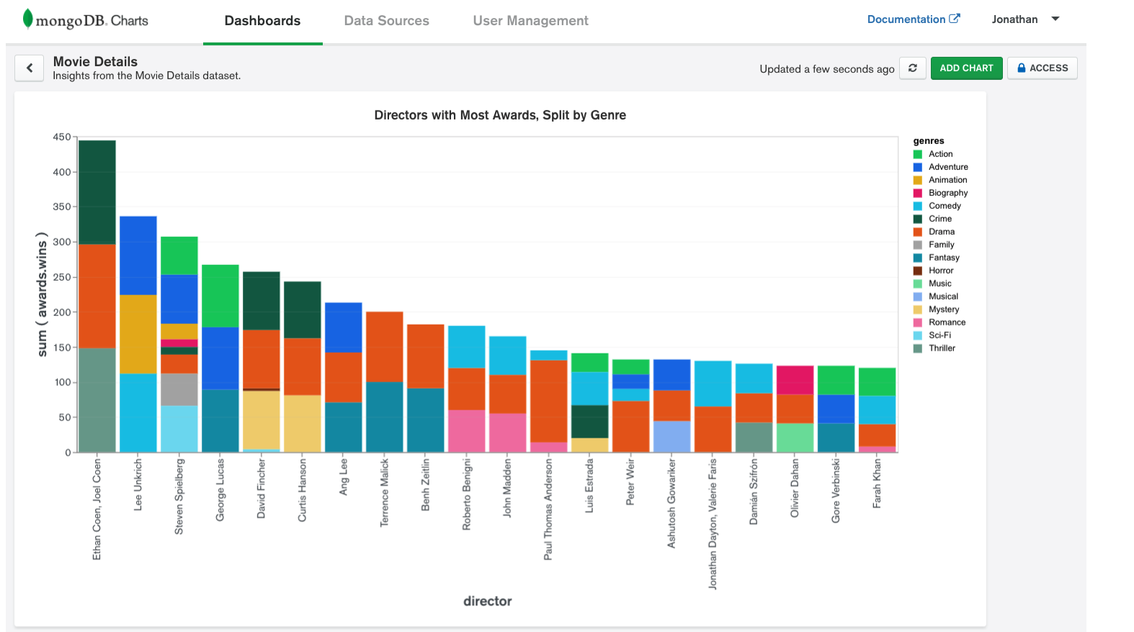
MongoDB Charts:
Tool to create visual representations of your MongoDB data.
Built in aggregation
Allows users to process your collection data by a variety of metrics and perform calculations such as mean and standard deviation to provide further insight into your data.

Slide 25
Why MongoDB?
Build applications faster.
Handle highly diverse data types.
Removes the complex ORM layer that translates objects in code to cells in relational tables.
Cost - Software, Hardware, development, deployment, licensing models.
Manage applications more efficiently at scale.
In contrast, to achieve scale with Oracle often requires significant, custom engineering work or investment in expensive, custom hardware.

Slide 26
When to use MongoDB?
High Write load - MongoDB by default prefers high insert rate over transaction safety.
High Availability - Setting replica Set (set of servers that act as Master-Slaves) is easy and fast. Moreover, recovery from a node (or a data center) failure is instant, safe and automatic.
Shard data - Databases scaling is hard (a single MySQL table performance will degrade when crossing the 5-10GB per table). If you need to partition and shard your database, MongoDB has a built in easy solution for that.
Location based - MongoDB has built in spatial functions, so finding relevant data from specific locations is fast and accurate.
Data is growing big and schema is not stable.
If no DBA, and user don't want to normalize data and do joins.

Slide 27
Use Cases
BillRun -
Schema-less design enables rapid introduction of new CDR(Call Data Records) types to the system. It let BillRun keep the data store generic.
Sharding enables linear and scale out growth w/o running out of budget.
With over 2,000/s CDR inserts, MongoDB architecture is great for a system that must support high insert load.
Location based is being utilized to analyze users usage and determining where to invest in cellular infrastructure.
Cisco -
Migrated its ecommerce platform from a legacy relational database to MongoDB.
Improved customer experience by reducing latency 8x and eliminated downtime during system upgrades. Its development teams can build and release new applications faster, while the company’s e-commerce platform can tap into the business agility enabled by cloud computing.

Slide 28
References
https://www.mongodb.com
https://docs.mongodb.com/manual/

